Slide 1
Technical Arts (TA 101AA) Engineering Graphics
Prof. Nachiketa Tiwari
Department of Design

Slide 2
Solids-Line Interactions

Slide 3

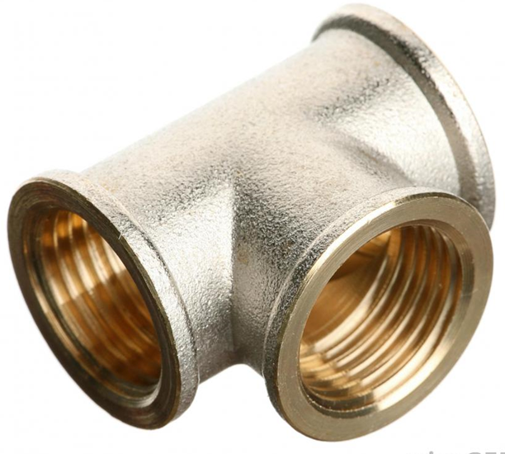
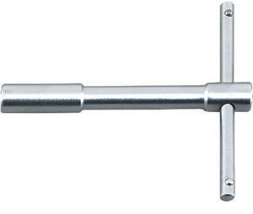
Purpose
We will deal with intersections of:
Line and Line
Plane and Line
Plane and plane
Solid and Line
Solid and Plane
Solid and Solid
Two surfaces that meet to form a curve of intersection.

Slide 4
Intersection of a Solid with a Line
A solid is a finite closed volume in space bounded by surfaces.
Intersection of line with solid is equivalent to lines with surfaces.
Bounding surfaces of a solid could be flat (plane) or curved.
Already know intersection of lines and planes.
Curved surfaces: Surfaces with single or double curvatures.
Here, we restrict ourselves to singly-curved surfaces only.
Examples: Cylinders and cones.
Singly-curved surfaces: Obtainable via straight line generators.
Cylinders & cone: Obtained by revolving a straight line about an axis.
The problem of intersection of line with singly-curved surfaces can be reduced to intersection between appropriate lines.

Slide 5
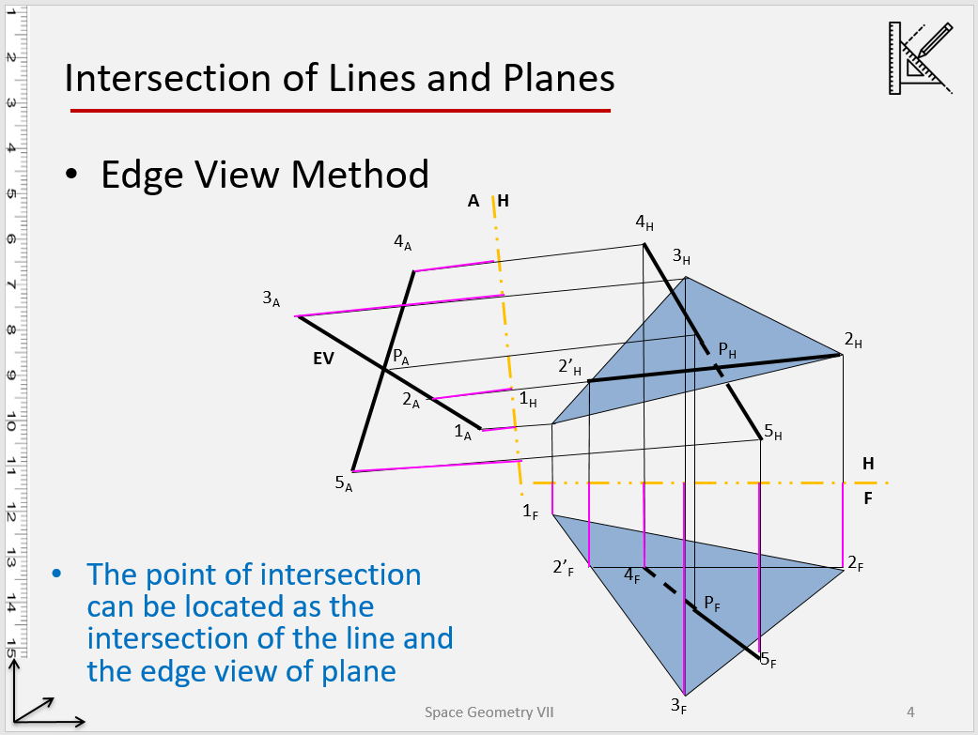
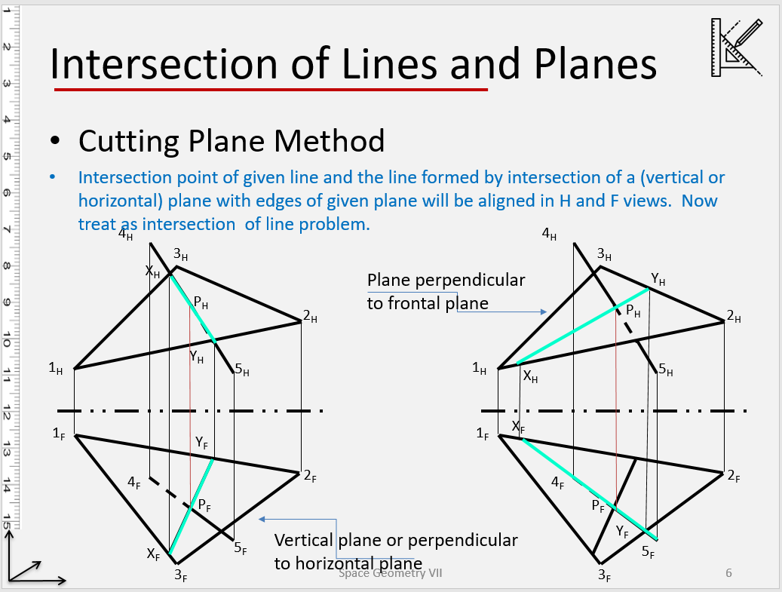
Intersection of a Line and a Plane
Edge view method
Cutting plane method

Slide 6
Intersection of an Oblique Line with an Oblique Plane
Oblique line: AB
Oblique plane: RST
Use the edge view method
A_{A}
A
H
R_{A,}S_{A}
P_{A}
T_{A}
A_{H}
S_{H}
TL
B_{A}
P_{H}
T_{H}
R_{H}
B_{H}
B_{F}
B_{P}
H
F
R_{F}
S_{F}
R_{P}
S_{P}
P_{P}
P_{F}
A_{F}
T_{F}
T_{P}
A_{P}
F
P

Slide 7
Intersection of a Pyramid and a Line
2_{H}
5_{H}
Given: Projections of a pyramid and a line. Determine the points of between the two.
Cutting Plane Method
More direct solution than EV method
Z_{H}
O_{H}
Y_{H}
1_{H}
X_{H}
4_{H}
3_{H}
H
F
O_{F}
Y_{F}
5_{F}
4_{F}
1_{F}
X_{F}
2_{F}
Z_{F}
3_{F}

Slide 8
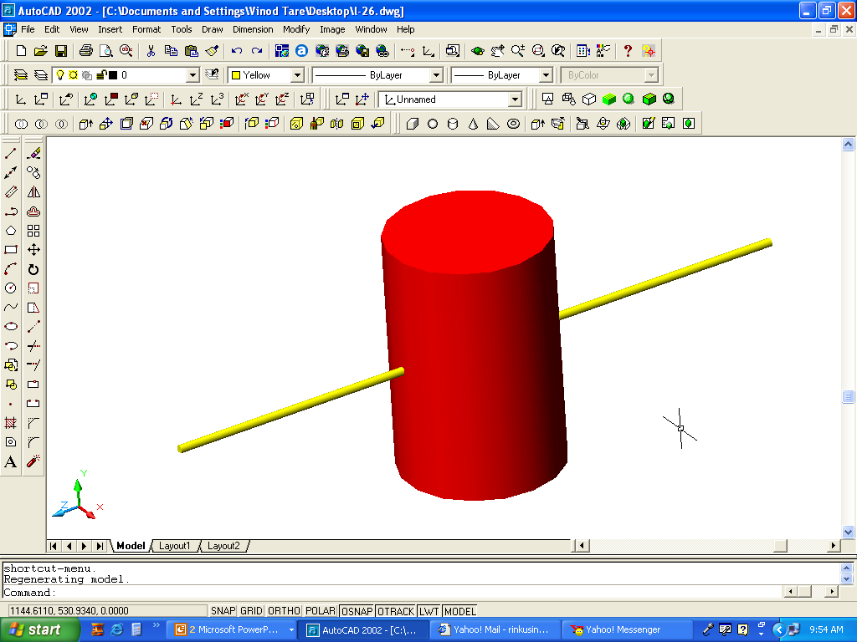
Intersection of a Line and a Cylinder
B_{H}
Q_{H}, Q’_{H}
Y_{H}
P_{H}, P’_{H}
Z_{H}
A_{H}
H
F
P_{F}
Q_{F}
B_{F}
Y_{F}
Z_{F}
A_{F}
P’_{F}
Q’_{F}

Slide 9
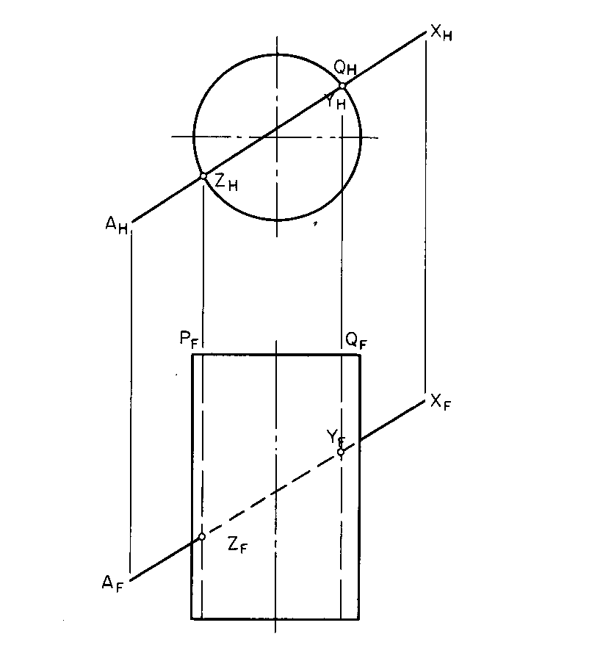
Intersection of a Line and The Curved Surface of a Cylinder
The top view determines the two piercing points as it is the edge view of the curved surface.

Slide 10
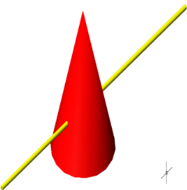
Intersection of a Line and a Cone
Project any two points X and Y on H and F planes.
Pass a cutting plane passing through the points V, X, and Y; extend it to base and locate points S and R in VP
Project S, R in HP view; S, R cuts cone at 1-2 at the base in HP; project 1-2 in VP
M is the point of intersection of V-2 with AB; and N is the point of intersection of V-1 with AB; project M and N in FV.
Points M and N are the desired points of intersection.
V_{H}
Y_{H}
A_{H}
X_{H}
N
B_{H}
M
R_{H}
H
S_{H}
2_{H}
1_{H}
F
V_{F}
A_{F}
Y_{F}
N
X_{F}
M
B_{F}
S_{F}
1_{F}
R_{F}
2_{F}

Slide 11
Intersection of a Solid with Plane

Slide 12
Recap: Intersection of Two Planes
Given: Views of two planes (1-2-3-4 and 5-6-7) on H & F. Determine the line of intersection.
Edge View Method
EV of a plane will intersect other plane at the line of intersection
Edge view of 1-2-3-4
EV could have been for 5-6-7 as well.
H
A
6_{A}
6_{H}
3_{A}
3_{H}
2_{A}
2_{H}
4_{A}
7_{A}
TL
4_{H}
4’_{H}
7_{H}
1_{A}
1_{H}
5_{A}
H
5_{H}
F
6_{F}
1_{F}
4’_{F}
4_{F}
2_{F}
5_{F}
3_{F}
7_{F}
Notes:
Edge View Method

Slide 13
Recap: Intersection of Two Planes
Given projections of two planes (1-2-3-4 and 5-6-7) on H and F. Determine the projections of line of intersection.
Cutting Plane Method
Vertical cutting plane having line 6_{H} - 7_{H}
Vertical cutting plane having line 6_{H} - 5_{H}
6_{H}
X_{H}
3_{H}
R_{H}
2_{H}
Y_{H}
4_{H}
S_{H}
7_{H}
1_{H}
5_{H}
H
F
6_{F}
1_{F}
S_{F}
Y_{F}
4_{F}
2_{F}
5_{F}
R_{F}
X_{F}
3_{F}
7_{F}
Notes:
Edge View Method
Line 6-7 is cutting the plane 1234 some where. We have to identify that location. Similarly line 56 is cutting the place 1234 somewhere and we have to identify that. Joining these two intersecting points will give us the line of intersection of the plane 1234 and 567. So we put a vertical cutting plane consisting the line 67. The cutting plane will also cut the plane 1234 along a line, i.e. XY. The lines XY and 67 intersect at a point on the plane—we need to locate this. The same point will be aligned with its projection on Frontal. So first we locate line XY on H and then transfer this to F and then find intersection of F projection of XY with F projection of 67. The point of intersection on F can then be projected on the H as both will be aligned. Same methd for line 56 also. Now joining these two points will give line of intersection and its projection on F and H.

Slide 14
Intersection of Two Planes: Case 1
A_{H}
A’_{H}
Oblique plane cutting principal plane of a solid
Cutting plane method
Two cutting planes perpendicular to Frontal
consisting of AA’
consisting of BB’
PQ is the line of intersection
P_{H}
B’_{H}
Q_{H}
H
F
A_{F}
A’_{F}
B_{F}
B’_{F}
P_{F}
Q_{F}
Notes:
A: Oblique Plane Intersecting an Oblique Plane of a Solid

Slide 15
Intersection of Two Planes: Case 2
A’_{H}
A_{H}
Oblique plane intersecting an inclined plane of a solid
Cutting plane method
Two cutting planes perpendicular to Frontal
consisting of AA’
consisting of BB’
PQ is the line of intersection
P_{T}
B’_{H}
B_{H}
Q_{T}
H
F
A_{F}
A’_{F}
B_{F}
B’_{F}
P_{F}
Q_{F}
EV
Notes:
A: Oblique Plane Intersecting an Oblique Plane of a Solid

Slide 16
Intersection of Two Planes: Case 3
S_{H}
W_{H}
Y_{H}
T_{H}
Oblique plane intersecting an oblique plane of a solid
Cutting plane method
Two cutting planes perpendicular to Frontal
consisting of AA’
consisting of BB’
One cutting point along YZ, and another one along WX.
PQ is the line of intersection
Q_{H}
B’_{H}
B_{H}
P_{H}
A’_{H}
A_{H}
R_{H}
X_{H}
Z_{H}
U_{H}
H
F
R_{F}
S_{F}
A_{F}
A’_{F}
W_{F}
P_{F}
X_{F}
B_{F}
B’_{F}
Q_{F}
Y_{F}
Z_{F}
U_{F}
T_{F}
Notes:
A: Oblique Plane Intersecting an Oblique Plane of a Solid

Slide 17
Intersection of a Plane and a Prism
Step I: Determine the expected number of intersection points
Line 1-4/EV → 2 points
Line 2-3/EV → 2 points
Vertical lines 9-14 and 7-12 / plane 1234 → 2 points
TOTAL 6 POINTS
5_{H,}10_{H}
6_{H,}11_{H}
X_{H}
3_{H}
2_{H}
EV
R_{H}
EV
7_{H,}12_{H}
9_{H,}14_{H}
EV
EV
Y_{H}
4_{H}
1_{H}
S_{H}
8_{H,}13_{H}
H
Step II: Locate intersection points
F
5_{F}
9_{F}
8_{F}
6_{F}
7_{F}
X_{F}
3_{F}
Step III: Connect the intersection points in logical manner
→ Move clockwise from IP to IP
2_{F}
R_{F}
4_{F}
Y_{F}
1_{F}
S_{F}
Step IV: Determine the visibility
Visibility of plane in regard to the prism
Visibility for the paths of intersection.
10_{F}
14_{F}
13_{F}
11_{F}
12_{F}

Slide 18
Intersection of a Plane & a Pyramid
A_{h}
Q_{h}
Cutting Plane Method
Check intersection of:
PQ with AOB
RS with BOC
BO with PQRS
PQ with AOC
RS with AOC
1_{h}
4_{h}
S_{h}
O_{h}
5_{h}
C_{h}
P_{h}
3_{h}
2_{h}
B_{h}
R_{h}
HP
VP
O_{v}
P_{v}
1_{v}
4_{v}
Check visibility for:
Path of intersection
Plane and solid
3_{v}
Q_{v}
R_{v}
2_{v}
5_{v}
S_{v}
B_{v}
A_{v}
C_{v}

Slide 19
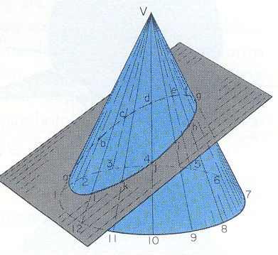
Intersection of a Plane & a Cone
Method 1: Selected Line Method - When an edge view (EV) of the plane is available!
In FP, the cone is seen as a triangle and the plane as Edge View.
Draw lines V-1, V-2 , etc. called ‘elements’ or ‘generators’ in top and front views.
The points of intersection of ‘generators’ and EV give the ‘line of intersection’ of plane and cone in FP.
Locate the points of intersection (e and i) in the HP.
Similarly, locate all other points of intersection in top view and draw the ‘curve of intersection.’
What will be the shape of the ‘curve of intersection’ in top view?
4
3
5
c
d
2
b
e
6
f
a
v
g
7
1
h
l
i
8
12
k
j
11
10
9
HP
v
FP
g
f
Plane in EV
e
h
d
i
c
j
a
b
k
l
4
5
2
3
6
7
12
11
10
9
8
1

Slide 20
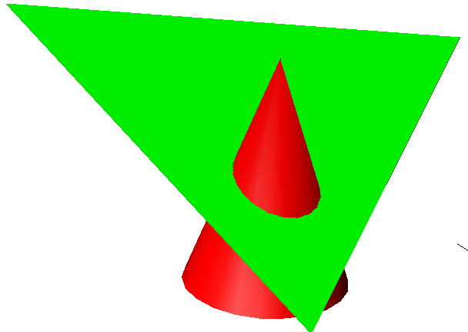
Intersection of a Plane & a Cone
5_{H}
B_{H}
A_{H}
4_{H}
6_{H}
When edge view of plane is NOT in F plane.
Edge view method
5’_{H}
6’_{H}
4’_{H}
3’_{H}
V_{H}
7’_{H}
7_{H}
H
3_{H}
2’_{H}
A1
1’_{H}
8’_{H}
8_{H}
2_{H}
H
1_{H}
F
V_{F}
C_{H}
V_{A1}
B_{A1}
A_{F}
C_{F}
6_{A1}
3’_{F}
2’_{F}
A_{A1,}
C_{A1}
4’_{F}
1’_{F}
7_{A1},
5_{A1}
8’_{F}
5’_{F}
7’_{F}
6’_{F}
4_{A1},
8_{A1}
We will need additional views for 4’_{H} 8’_{H} and 1’_{F} 5’_{F}
3_{F}
7_{F}
2_{F},4_{F}
1_{F},5_{F}
8_{F}, 6_{F}
B_{F}
1_{A1},
3_{A1}
2_{A1}

Slide 21
Intersection of plane & cone—Cutting Plane Method
5_{H}
6’_{H}
B_{H}
A_{H}
4’_{H}
5’_{H}
4_{H}
5
6_{H}
3_{H}
3’_{H}
7_{H}
7’_{H}
V_{H}
2’_{H}
1
8_{H}
2_{H}
1_{H}
1’_{H}
8’_{H}
H
F
V_{F}
C_{H}
V_{P}
A_{F}
3’_{F}
2’_{F}
C_{F}
C_{P}
1’p
1
A_{P}
3
2
1
4’_{F}
4
8
8’_{F}
7
5
5
5’p
7’_{F}
6
5_{P}
3_{F}
2_{F} , 4_{F}
1_{F} , 5_{F}
8_{F} , 6_{F}
7_{F}
1_{P}
8_{P} , 2_{P}
7_{P} , 3_{P}
6_{P} , 4_{P}
6’_{F}
B_{F}
B_{P}

Slide 22
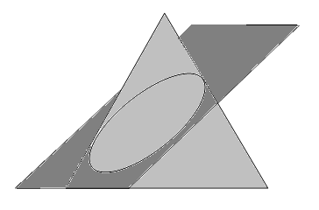
Intersection of a Plane & a Cone
Method 2: Cutting Plane Method -When an oblique plane cuts the cone
Draw generators in both top and front views.
Pass a ‘vertical cutting plane’ through generators
V-2 and V-8, it will be in EV in top view.
The ‘cutting plane’ cuts the cone in two halves; and cuts the oblique plane at points X and Z.
Transfer the points X-Z in the VP.
Points of intersection of line X-Z with generators
(V-2 and V-8) in VP yield desired ‘points of intersection of cone and the oblique plane’.
Transfer these ‘points of intersection’ (b and h) from VP to HP.
Similarly, get all other points of intersection.
4
3
5
2
X_{H}
c
6
b
d
e
a
v
f
1
g
7
l
h
Z_{H}
12
i
8
k
Cutting plane
11
j
9
10
HP
v
VP
c
d
e
f
g
Z_{F}
X_{F}
i
h
b
j
a
l
k
1
2
3
4
5
6
7
12
11
10
9
8

Slide 23
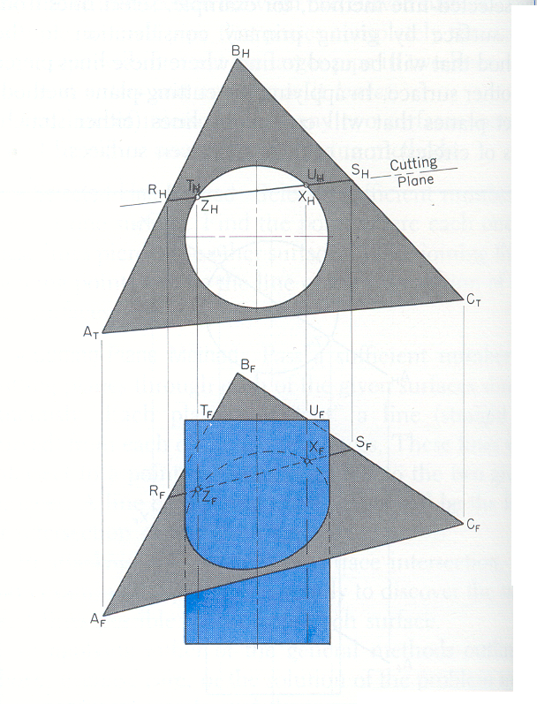
Intersection of Oblique Plane and Cylinder

Slide 24
Thank You

